Slide 1
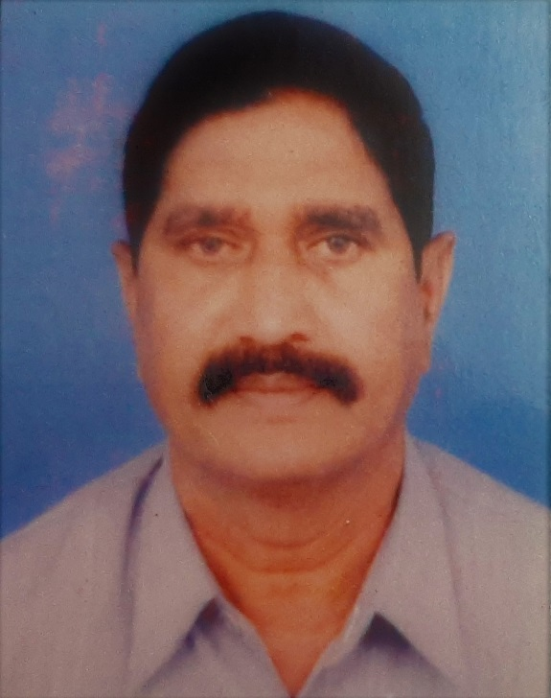
Awardee: Shri J.N Mogal Designation: Vehicle Operator (Retd.) DRDO (A&A), Ministry of Defence
Shri Mogal in his own simple way he has left an account of his career as a Driver of explosive vans, staff cars, ambulances, while working in DRDO.
In his brief, nevertheless, important ANUBHAV, he has left an account of how he saved lives during his career, whether it be during the Earthquake in Latur or different accidents witnessed by him while performing his duties.
In his account he has expressed happiness and satisfaction for duties done honestly and diligently without seeking any reward.

Slide 2
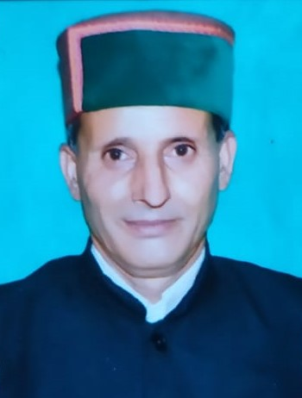
Awardee: Shri Sita Ram Himral Designation: Postman Department of Posts
Shri Sita Ram Himral served for 39 years in the Department as a Postman.
He has left his ‘Anubhav’ highlighting his commitment towards the job despite its intrinsic perils, such as crossing the Satluj River on make shift swings, crossing drains without bridges to reach one village after the other to deliver Dak.
Shri Sita Rams’ Anubhav of 39 years is appreciated, since it shows that no job is small and that it is because of these foot soldiers that the Government is able to deliver.

Slide 3
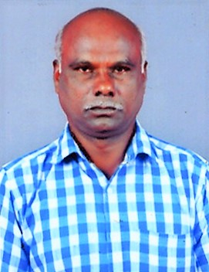
Awardee: Shri S. Kanagaraj Designation: Asst Sub-Inspector, Central Reserve Police Force Ministry of Home Affairs
Shri S.Kanagaraj, ASI, through his ‘Anubhav’ has left a very inspiring account of a true patriot who experienced multiple field-level operations at ground level with terrorists.
Whether it be with the LTTE in Bangalore, militants in J&K, Maoists in West Bengal or North East counter-insurgency operations, the officer remained true to the cause of his force.
In his narrative, he explains how unflinching trust in his senior officers & subordinates helped him in achieving success. Though a tough and risky life, he talks about the positive aspects of the job, such as opportunities to witness different cultures, weather conditions, life-styles and cuisines in different states while serving.

Slide 4
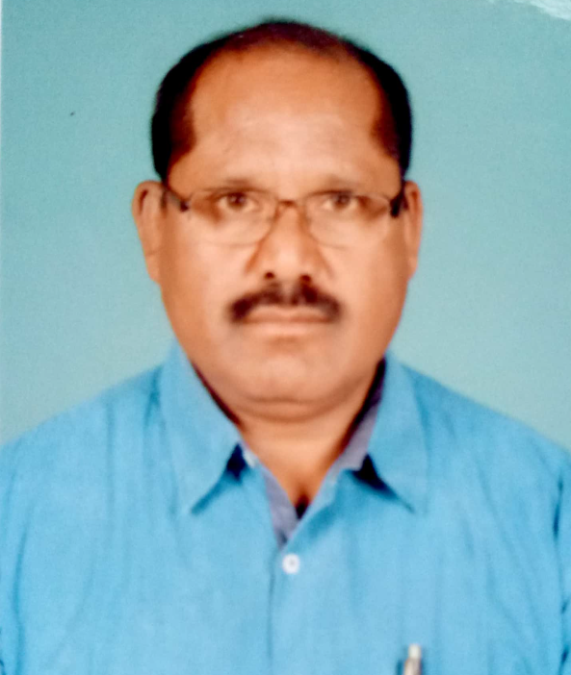
Awardee: Shri Madan Gopal Designation: Inspector, Central Industrial Security Force Ministry of Home Affairs
Shri Madan Gopal has left an excellent account of his career spanning 36 years in the CISF.
The narration is inspiring since it lays stress on discipline, punctuality, hard work, honesty, effectiveness, cordial behaviour, alertness and respect for seniors while serving in the force.
Shri Gopal has left an interesting record of his contribution while serving in ONGC, NTPC, Metro and Airports.
The retired officer is full of praise of the CISF which has helped him in more ways than one and his Anubhav will inspire many to join the force.

Slide 5
Awardee: Ms. Kshipra Misra Designation: Scientist F (Retd.) Defence Research & Development Service (DRDS) Ministry of Defence
Ms. Misra through her ‘Anubhav’ has left a wealth of information on how she devoted herself to research projects and developed DRDO Arsenic Removal Technology (DART) for ground water purification.
She has also left an inspiring account for future generations of her contribution towards development of therapeutic interventions from herbal sources for protecting Armed Forces deputed at high altitudes from hypobaric hypoxi conditions.

Slide 6
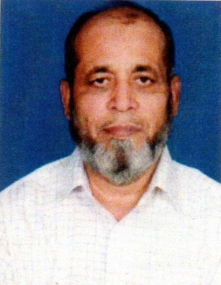
Awardee: Shri Basheer Ahammad Kaji Designation: Sub-Inspector, Central Reserve Police Force Ministry of Home Affairs
Shri Basheer in a career spanning about 38 years in CRPF has left an inspiring account of risky anti-militant operations in which he was involved in the various states of Arunachal, Punjab, Manipur, Tripura, Assam and J&K.
He recalls the high traditions and discipline and secular nature of the force in which he served.
His detailed account of operations against militants in Punjab at the risk of his life as well as his participation of Earthquake relief operations in Gujarat will inspire many.

Slide 7
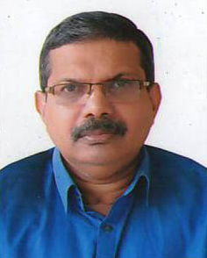
Awardee: Shri Suresh N. Designation: Technical Officer –D (Retd.) Department of Space
Shri Suresh N. has left behind an inspiring ‘Anubhav’ which is divided in two parts one which is an account of his contribution while physically fit and another after an ailment which confined him to a wheel chair.
It is an account meant both for people suffering physical ailments while in service and another for colleagues who through their motivation and encouragement can get the best output from such officers.
His numerous contributions are in the field of HPS 3, nozzle structural backup, Auto CAD sketches for various shop Floor fixtures, Rollers, Feeding Eye for various Filament Winding requirements.

